Slide 1
Modeling the pandemic – Estimating the effects of NPIs
We have seen how epidemiologists of infectious diseases model their spread
These models can be useful to make projections of the epidemic under different scenarios
But in order to guide decision-making, we need to know how different interventions would affect the epidemic
This is the question to which we now turn

Slide 2
Modeling the pandemic – Estimating the effects of NPIs
What are government interventions?
People can change their behavior voluntarily, but they can also be coerced to change it by government interventions
Pharmaceutical vs. non-pharmaceutical interventions
When a new pathogen emerges, it’s going to be mostly non-pharmaceutical interventions (NPIs) at first (even if some existing therapeutics work, you need to be reasonably sure before you start using them on millions of people, for economic and ethical reasons)
Examples of NPI: curfews, business closures, school closures, various types of stay-at-home orders, etc. (governments can be very imaginative)

Slide 3
Modeling the pandemic – Estimating the effects of NPIs
Scientists have used many different methods to estimate the effects of NPIs, but they can be classified into roughly 2 types
“Epidemiological” method vs. “econometric” method
The first makes strong assumptions about the underlying causal process, while the second is seemingly more agnostic about that, though we’ll see that it’s somewhat misleading to say that

Slide 4
Modeling the pandemic – Estimating the effects of NPIs
We start with the first method, which was used by the most cited paper on the effects of NPIs, i. e. Seth Flaxman et al., “Estimating the effects of non-pharmaceutical interventions on COVID-19 in Europe”, Nature, 2020
This paper was published in June 2020, just after the first wave in Europe, and received a lot of publicity
The authors claim to show that NPIs, and especially lockdowns, reduced transmission a lot and saved ~3 million lives in Europe alone during the first wave

Slide 5
Modeling the pandemic – Estimating the effects of NPIs
How did they do it?
On this approach, one starts by specifying a model of how the virus is spreading
In this case, they basically used a SIR model, but with time-varying parameters
More specifically, the basic reproduction number or, if you prefer, the transmission rate at time t was allowed to vary depending on which NPI was in place at time t

Slide 6
Modeling the pandemic – Estimating the effects of NPIs
The main equation of the model basically says :
In this equation, t is the time, m is the country and f_{m}(t) is a function of time whose value is always positive but can be less than 1
f_{m}(t) is the effect of all the NPIs in place in country m at time t
$R_{t,m}=R_{0,m}f_{m}\left(t\right)$

Slide 7
Modeling the pandemic – Estimating the effects of NPIs
Here is the effect of intervention i and is also a positive number that can be less than 1
So they assume that the effects of interventions are multiplicative
For instance, suppose there are 3 interventions in place at time t that each reduce transmission by 10%, then we have:
$f_{m}\left(t\right)=g_{1}\left(t\right)∗...∗g_{k}\left(t\right)$
$g_{i}\left(t\right)$
$f\left(t\right)=g_{1}\left(t\right)∗g_{2}\left(t\right)∗g_{3}\left(t\right)=0.9∗0.9∗0.9≈0.73$

Slide 8
Modeling the pandemic – Estimating the effects of NPIs
$g_{i}\left(t\right)=α_{i}$
if intervention i is in place at time t and 1 otherwise
So α_{i} is the effect of intervention i and we want to know what it is for each intervention 1, …, k
How do they do that? They did something called “fitting the model to the data” to find the value of each α_{i}
Basically, you can think of it as a kind of smart “trial and error”, where you try different combinations of values for those parameters and run the model until you’ve found a combination that results in a model run that approximates the real data as much as possible

Slide 9
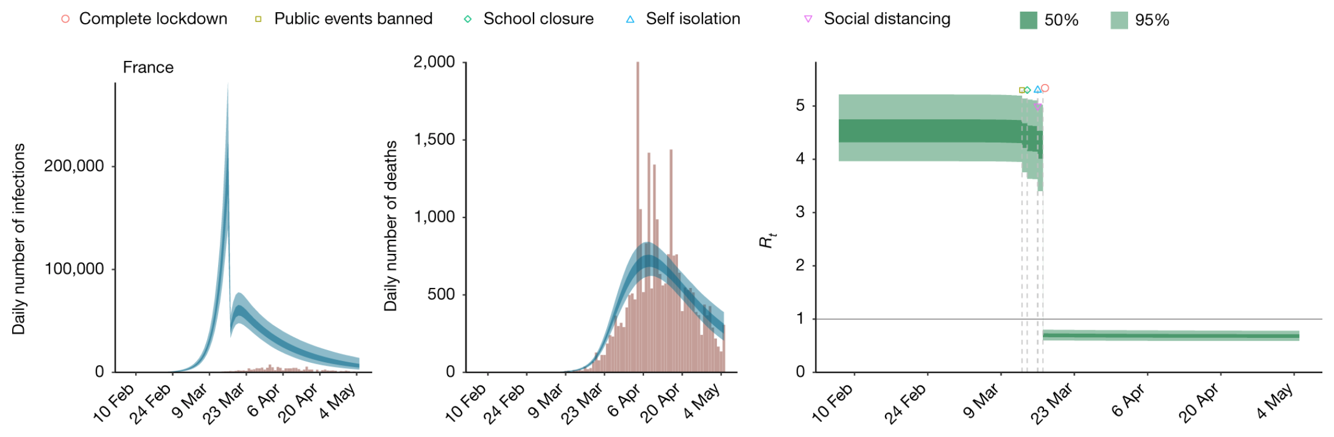
Modeling the pandemic – Estimating the effects of NPIs
Example of model fit

Slide 10
Modeling the pandemic – Estimating the effects of NPIs
Once you have estimated the α_{i}’s, hence the g_{i}’s and thus f_{m} for each country m (I’ll explain later why there is a different function for each country), you can use that to estimate how many lives the NPIs saved
To do that, just assumes no NPIs were implemented and run the model under that assumption, i. e. so that g_{i}(t) = 1 for every intervention i and every t (since we’re in a counterfactual were no NPIs were implemented) and therefore f_{m}(t) = 1 for every t
Then do the same thing but with f_{m} as estimated by fitting the model from the data, assuming the NPIs were in place as in the real world
Finally, you substract the total number of deaths in that second scenario from the total number of deaths in the counterfactual, which gives you an estimate of the numver of deaths that were averted by NPIs according to the model

Slide 11
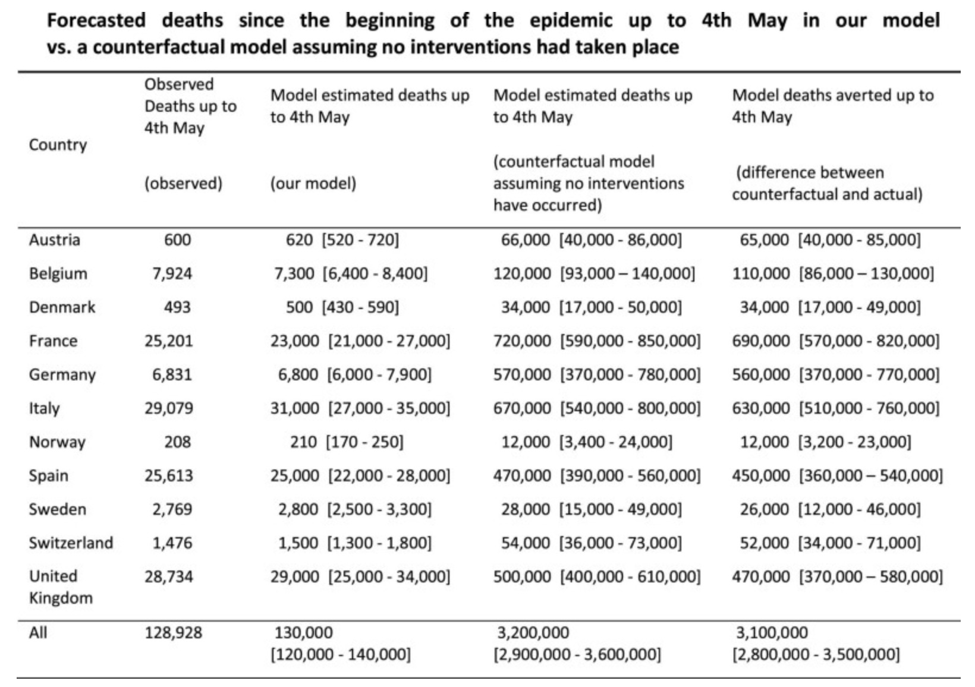
Modeling the pandemic – Estimating the effects of NPIs

Slide 12
Modeling the pandemic – Estimating the effects of NPIs
However, there are several problems with this general approach, as well as problems specific to what Flaxman et al. did
Let’s start with the former kind of problems
Strictly speaking, what this method does is this: if the model accurately describes the spread of the virus, what are the likely effects of the NPIs given the observed data

Slide 13
Modeling the pandemic – Estimating the effects of NPIs
So the validity of this method is premised on the idea that the model fitted to the data accurately describes the spreading process
In general, it’s difficult to be confident that this is the case and, in the case of the model used by Flaxman et al. specifically, it’s clearly false for reasons we’ll examine shortly
But for the moment it suffices to say that the model rests on the very strong assumption that transmission is only affected by NPIs
In particular, voluntary changes of behavior are supposed not to have any effect on it, nor is population structure (i. e. the model assumes homogenous population mixing)

Slide 14
Modeling the pandemic – Estimating the effects of NPIs
But what if that’s not true and other factors beside NPIs have a large effect on transmission?
One way to see that the method is not reliable in this case is to use simulations
The idea is to generate a fake epidemic with a model in which other factors had a large effect and fit the model used by Flaxman et al. to those simulated data to see what it concludes
Since we generated the data ourselves, unlike with real data, we know exactly what the data generating process was, so we’ll be able to tell if the conclusions that Flaxman et al.’s model draws from them are correct

Slide 15
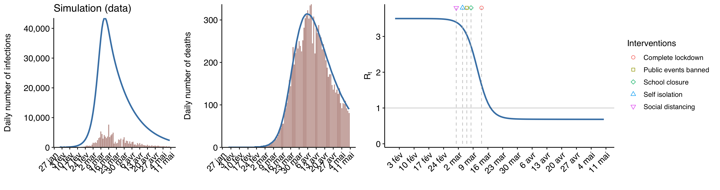
Modeling the pandemic – Estimating the effects of NPIs
Simulated epidemic in which NPIs had no effect

Slide 16
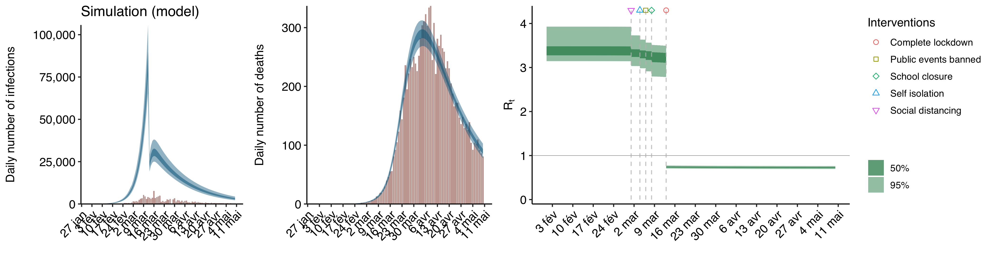
Modeling the pandemic – Estimating the effects of NPIs
The result of fitting Flaxman et al.’s model to those data

Slide 17
Modeling the pandemic – Estimating the effects of NPIs
So even though the NPIs had no effect on transmission, we know because those are simulated data that we generated ourselves, if you fit the model used by Flaxman et al. to them it concludes that they had a massive effect, especially the last one
This makes perfect sense when you think about it: since in the data we fed it R collapses after a while, it had to ascribe this reduction to something and, since the model assumes that only NPIs can have any effect on transmission, NPIs were the only thing it could ascribe it to
Of course, this doesn’t prove that NPIs had a large effect (in this case we know they had none), it’s just that there is no other way for the model to fit the data
This is also how the French epidemiologists working at the INSERM who advised the government “proved” that the curfew had a massive effect in 2021

Slide 18
Modeling the pandemic – Estimating the effects of NPIs
We have seen that Flaxman et al.’s model would also fit simulated data that were generated by a completely different process than it assumes
But can we also fit the real data to a completely different model that assumes NPIs had no effect?
Yes, we can, for instance you get a very good fit to the real data if you assume a model in which people’s voluntarily changed their behavior so that R went down according to a sigmoid function and NPIs had no effect on transmission

Slide 19
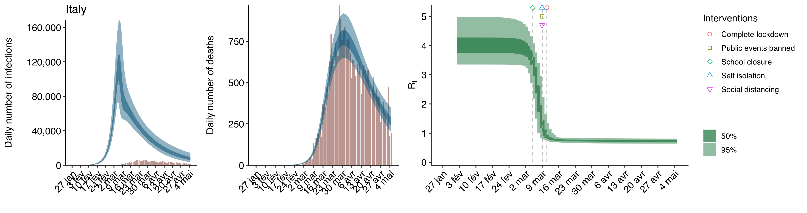
Modeling the pandemic – Estimating the effects of NPIs
Example of fitting real data to this model

Slide 20
Modeling the pandemic – Estimating the effects of NPIs
So we see that, when you use this approach, your conclusions may be completely false if the model you use doesn’t correctly describe the spreading process
In the case of the model used by Flaxman et al. (2020), we actually have very good reasons to think it doesn’t
To see why, we must look at the results of fitting the model to the data to estimate the effects of the NPIs

Slide 21
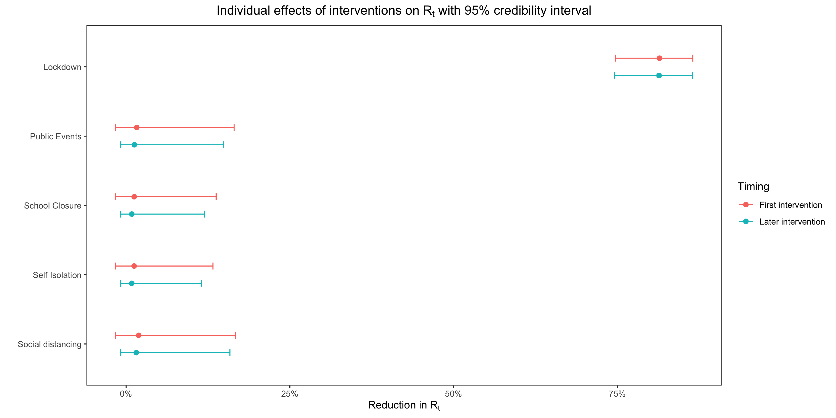
Modeling the pandemic – Estimating the effects of NPIs

Slide 22
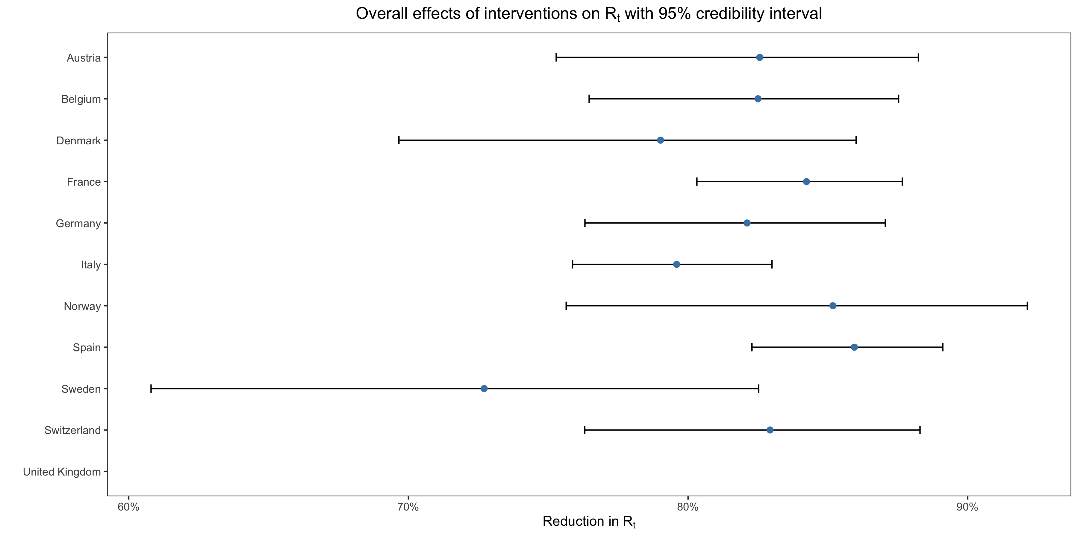
Modeling the pandemic – Estimating the effects of NPIs

Slide 23
Modeling the pandemic – Estimating the effects of NPIs
So when you fit the model to the data, you find that 1) NPIs collectively had a very large effect on transmission in every country and 2) only full lockdowns had a large effect on transmission
But those 2 findings are at odd with each other
Indeed, one of the countries they looked at is Sweden, where there was no lockdown!

Slide 24
Modeling the pandemic – Estimating the effects of NPIs
How is that possible?
The answer is that, in the model, Flaxman et al. added a country-specific effect to allow the last intervention in each country to have a somewhat different effect than the same intervention in other countries due to idiosyncratic factors
The last intervention was a full lockdown everywhere except in Sweden where it was a ban on public events

Slide 25
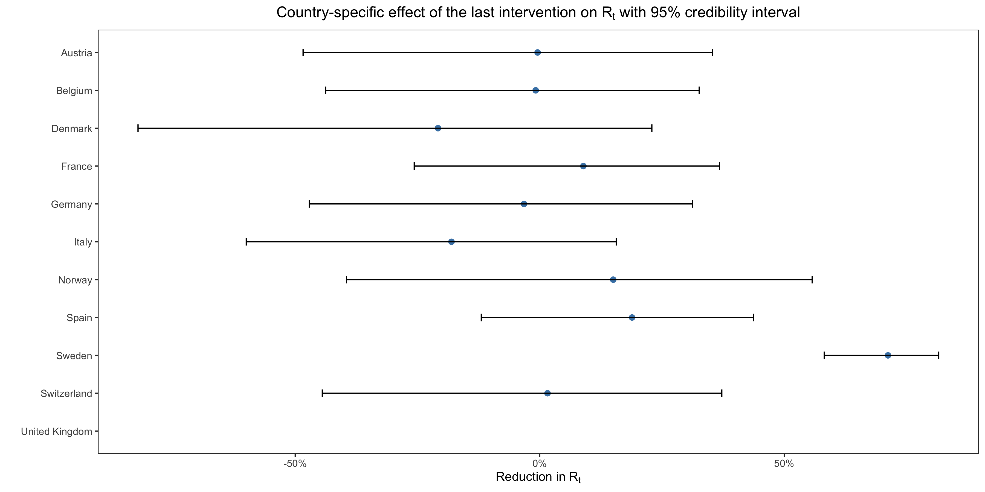
Modeling the pandemic – Estimating the effects of NPIs

Slide 26
Modeling the pandemic – Estimating the effects of NPIs
The country-specific effect of the last intervention is approximately zero everywhere except in Sweden where it’s huge
What this means is that, according to the model, banning public events reduced transmission by ~1.6% everywhere except in Sweden where it reduced it by ~72.2% (almost 45 times more!)
Of course, this is not true, it’s just that since the epidemic receded pretty quickly in Sweden and there was no lockdown to which this reduction of transmission could be attributed by the model, it had to attribute it to something and the country-specific effect of the last intervention was the only thing it could attribute it to
But Flaxman et al. neglected to report this small detail in the paper!

Slide 27
Modeling the pandemic – Estimating the effects of NPIs
To summarize, the problem with the epidemiological approach is that, in order to be reliable, we have to be confident that we understand the underlying causal process well and, as we have seen when we talked about the SIR model and its variants, we are not
This is a general problem with the way in which statistics is used to make causal inference in science: even sophisticated statistical methods rest on very strong assumptions that we often don’t have very good reasons to make
It’s very important to understand that, when scientists say they have estimate the effect of something “from the data”, what they really mean is: from the data + a model that includes many (often dubious) assumptions
Even though it seems more “agnostic”, this is also true of the econometric approach, to which we now turn

Slide 28
Modeling the pandemic – Estimating the effects of NPIs
The second approach, which I call the “econometric approach”, is — prima facie at least — completely different
Roughly, instead of assuming a model of the disease spread and fitting the data to that model in order to infer its parameters, this approach consists in looking at the correlation between the presence of restrictions and the growth rate of the epidemic or some related quantity, such as R
Correlation is a statistical relationship between 2 variables indicating whether and to what extent knowing the value of one tells you something about the value of the other

Slide 29
Modeling the pandemic – Estimating the effects of NPIs
Most of the times, when people talk about “correlation”, they are talking about Pearson’s correlation coefficient
This coefficient is between -1 and 1 and indicates the strength of the linear relationship between the variables
The closer to 1 or -1, the stronger that relationship, while a coefficient of 0 means there is no association

Slide 30
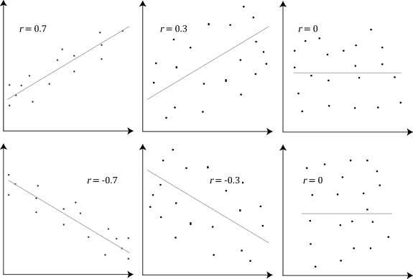
Modeling the pandemic – Estimating the effects of NPIs

Slide 31
Modeling the pandemic – Estimating the effects of NPIs
But the word “correlation” is also used more broadly to refer to any statistical association between 2 variables
In the case of NPIs, the idea behind this approach is that, if NPIs reduce transmission, there should be a negative correlation between the presence of a NPI and the growth rate of the epidemic
The problem is that, while it can be done in certain conditions, it’s not straightforward to infer causation from correlation

Slide 32
Modeling the pandemic – Estimating the effects of NPIs
The effects of NPIs, or lack thereof, could be confounded by a variety of factors
If you know what factors affect transmission beside the NPIs, you can include them in your statistical model to estimate the effects of NPIs other things being equal
But as we have seen, we don’t have a very good grasp of the underlying causal process, so we can’t really be confident that our estimates of the effects of NPIs are accurate
So while the econometric approach seems more agnostic than the epidemiological approach, in reality it rests on similarly strong assumptions, even if they are not always made explicit
For instance, most of the econometric models that people have used to estimate the effects of NPIs during the pandemic implicitly rested on the homogeneous mixing assumption, which as we have seen is dubious

